Slide 1

SSH and Key-Based Authentication
SSH Protocol
Secure Shell (SSH) is a cryptographic network protocol for operating network services securely over an unsecured network. SSH was designed as a replacement for Telnet and for unsecured remote shell protocols such as the Berkeley rlogin, rsh, and rexec protocols.
There are several ways to use SSH; one is to use automatically generated public-private key pairs to simply encrypt a network connection, and then use password authentication to log on.
SSH is typically used to log into a remote machine and execute commands, but it also supports tunneling, forwarding TCP ports and X11 connections;
It can transfer files using the associated SSH file transfer (SFTP) or secure copy (SCP) protocols.
Plan:
Public and Private Keys
Key-Based Authentication
Hard and Soft Links
Resources
by Iryna Diudiuk

Slide 2
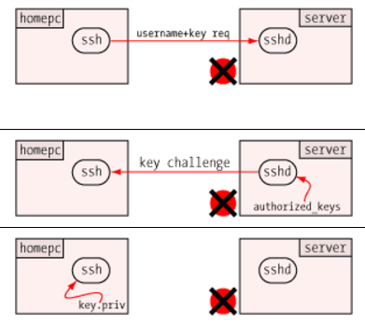
SSH and Key-Based Authentication
Public Key:
When a user creates a pair of public and private keys, and installs the public key in his $HOME/.ssh/authorized_keys file on the target server;
A public key is a long string of bits encoded in ASCII, and it's stored on one long line;
It includes a type (ssh-rsa, or others), the key itself, and a comment to whom it belongs;
This key must be installed on the target system — one time — where it is us;d for subsequent remote access by the holder of the private key.
using public key access means you type the same passphrase no matter which system you're connecting to.
Below is the screenshot dislaying ssh keys-based authentification:
SSH Keys
On Unix-like systems, the list of authorized public keys is typically stored in the home directory of the user that is allowed to log in remotely, in the file ~/.ssh/authorized_keys.
This file is respected by SSH only if it is not writable (600) by anything apart from the owner and root.
When the public key is present on the remote end and the matching private key is present on the local end, typing in the password is no longer required
Private Key:
It is for your personal use only;
for additional security the private key itself can be locked with a passphrase. In this case the user is prompted for the passphrase to unlock the private key;
ssh uses the private key to construct a key response, and sends it to the waiting sshd on the other end of the connection. It does not send the private key itself
by Iryna Diudiuk

Slide 3
SSH and Key-Based Authentication
Red Hat Enterprise Linux 6 uses SSH Protocol 2 and RSA keys by default;
RSA provides encryption, digital signatures and key distribution.
DSA provides only digital signatures.
In terms of speed, RSA is supposedly quicker than DSA, however the difference is barely noticeable;
Key-Based Authentication
To enforce key-based authentication we need to disable the standard password authentication. To do so, open the /etc/ssh/sshd_config configuration file in a text editor and change the PasswordAuthentication to “no”
To be able to use ssh, scp, or sftp to connect to the server from a client machine, authorization key pair needs to be genreted. Keys must be generated for each user separately.
If the key pair is generated as root, as only root would be able to use those keys;
After keys are generated with ssh-keygen command, the rights of the ~/.ssh/ directory need to be changed to 700;
Permissions to ~/.ssh/authorized_keys need to be 600;
by Iryna Diudiuk

Slide 4
Hard and Soft Links
Hard links:
A hard link to a file is indistinguishable from the original directory entry;
Any changes to a file are effectively independent of the name used to reference the file. Hard links may not normally refer to directories and may not span file systems. Hard links is that they have to be located within the same file system
By default hardlinks files are created with the same rights as the file they link to which is 664;
The ln command make links between files. By default, ln makes hard links;
The syntax is as follows: ln {source} {link}
A hardlink – is like a new name to the file as they share the same inode value.
Soft Links:
Soft are also calle d- symbolic links;
By defult files for softlinks are created with 777 rights and have additional letter l before the rights columns specifying that this is the soft link;
Soft link a new file that points to the location of anotherf file, like a shortcut points to a program in Windows;
Files created for the soft links will have different inode values;
Symbolic links may span file systems.
by Iryna Diudiuk

Slide 5
SSH and SSH Keys configuration
Resources:
https://en.wikipedia.org/wiki/Secure_Shell
http://clubmate.fi/symbolic-links-and-hard-links-creating-updating-deleting-and-all-that/
http://www.unixwiz.net/techtips/ssh-agent-forwarding.html
by Iryna Diudiuk

